Slide 1
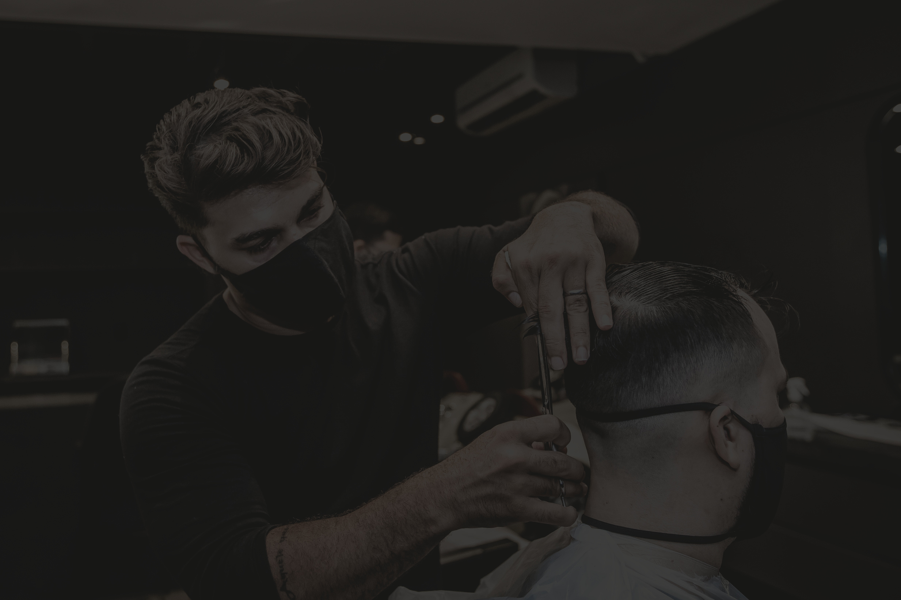
BUSINESS DATA MANAGEMENT
CAPSTONE PROJECT
Cutting-edge Solutions: Ajju’s Hair Cut Saloon Transformation
NAME: VIKAS JHA
ROLL NUMBER: 23F1001674
01

Slide 2
Contents
1) Executive Summary
2) Data Collection & Cleaning
3) Data Analysis
4) Interpretation of Results
5) Recommendation
Introduction to business
Data collection and Cleaning Steps
Analysis done in respect to the challenges
Important Insights about business
Solutions / Recommendations for business
02

Slide 3
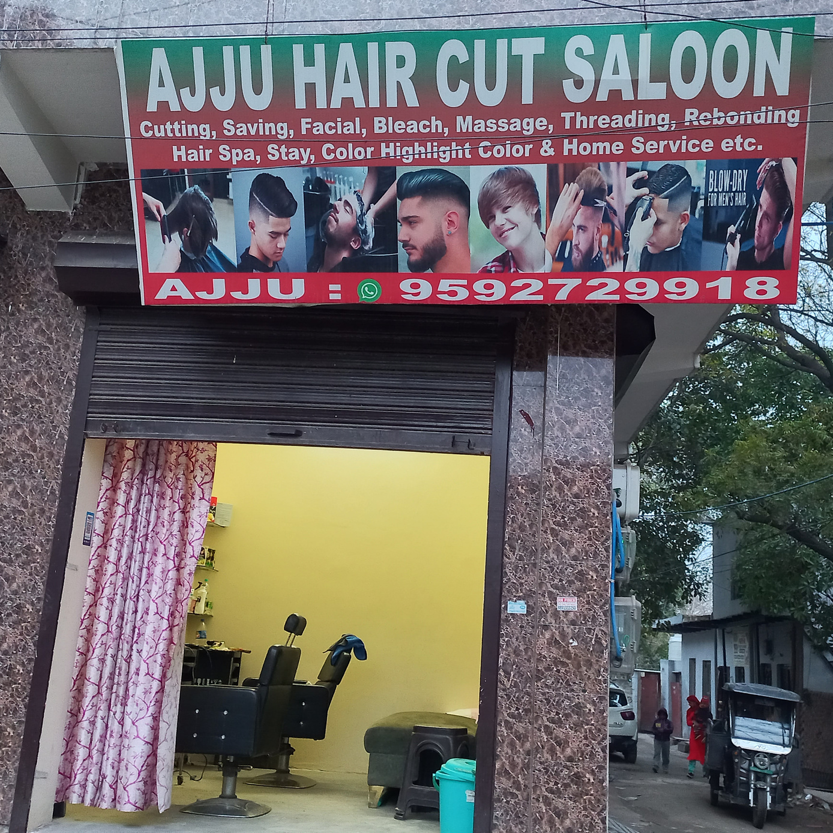
Executive summary
Business Overview: Ajju Hair Salon
Location: Situated in Gram Sabha, North West Delhi, Ajju Hair Salon operates as a local B2C establishment.
Services: Specializing in grooming services, the salon offers a range of services including haircuts, styling, and related grooming services.
Target Audience: The primary clientele consists of local residents within the community.
Objectives
- Daily Customer Trends Over Time
- Day Perception and Customer Behavior
- Margin and Profit Analysis of Services
- Missed Customers and Impact on Revenue
03

Slide 4
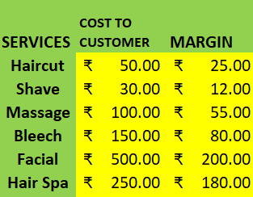
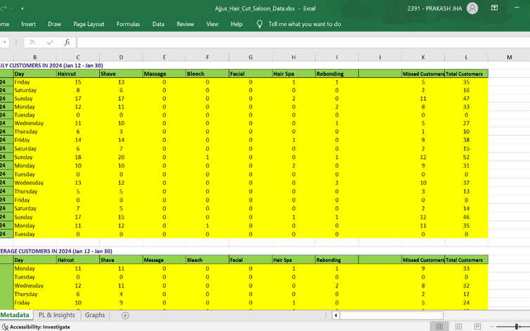
Data Collection & Cleaning
On-Site Daily Visits:
Regular on-site visits to Ajju Hair Salon throughout the month of January.
Direct observation to record the average number of customers daily.
01
Data Points Recorded:
Collected data on a variety of parameters, including Date, Day, and services availed (Haircut, Shave, Massage, Bleach, Facial, Hair Spa, Rebonding).
Additional metrics such as Missed Customers and Total Customers were also documented.
02
03
04
05
Excel Columns:
Created columns for Date, Day, specific services, and customer-related metrics.
Columns included Haircut, Shave, Massage, Bleach, Facial, Hair Spa, Rebonding, Missed Customers, and Total Customers.
Mathematical Formulas:
Developed mathematical formulas within Excel to calculate daily revenue.
Formulas involved multiplying fixed service prices by the number of customers for each service.
Graphical Enhancements:
Integrated graphical representations, such as bar charts and trend lines, for visualizing customer trends over time.
Screenshots of Excel charts and graphs were included for a more enhanced presentation.
04

Slide 5
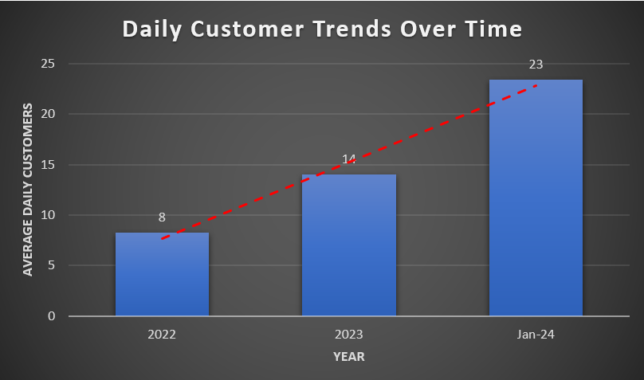
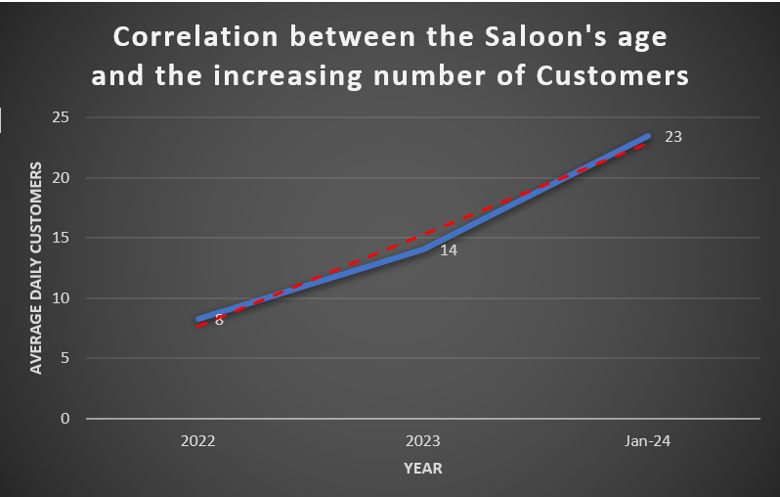
Data Analysis
Objective-1
Daily Customer Trends Over Time:
Steady Growth in Daily Customers:
The analysis reveals a consistent growth in daily customers over the years.
In 2022, the salon averaged 8 daily customers, which increased to 14 in 2023 and surged to 23 in 2024.
A visually impactful bar chart with a trend line illustrates this progression, highlighting the salon's effective strategies in customer acquisition and retention.
01
Positive Trajectory Emphasized by Graph:
The accompanying graph not only portrays the rise in daily customers but also underscores the overall positive trajectory of the salon.
This upward trend serves as a testament to the salon's increasing popularity and the efficacy of its business strategies in attracting and maintaining a growing customer base.
02
Role of Salon's Age in Customer Acquisition:
The salon's age emerges as a pivotal factor in customer acquisition, with a matured salon experiencing enhanced reputation, customer base, and overall attractiveness.
A correlated line chart visually depicts the positive relationship between the salon's age and the increasing number of customers.
This correlation underscores the significance of brand loyalty and reputation, indicating that established salons tend to attract a broader customer base, contributing to sustained growth.
03
05

Slide 6
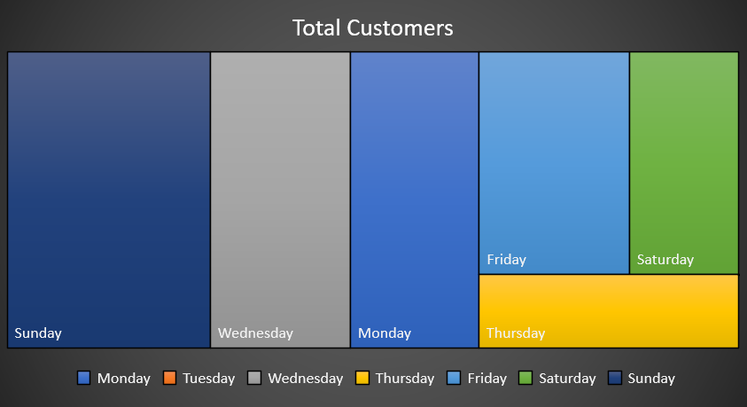
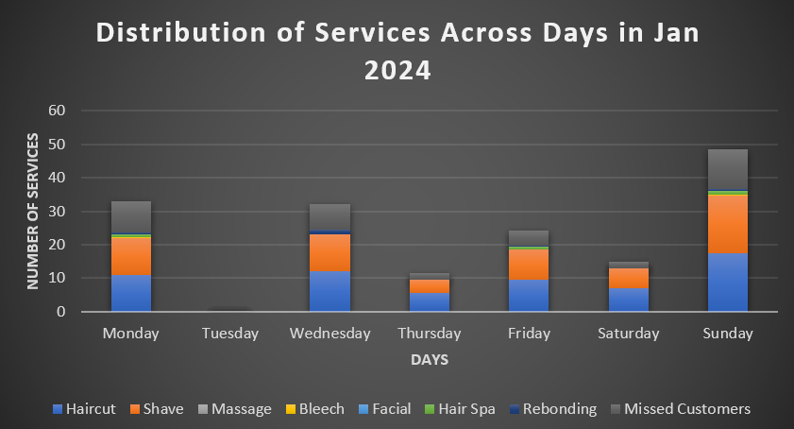
DATA ANALYSIS
objective 2
Day Perception and Customer Behavior
Nuanced Understanding of Customer Behavior:
Analysis of the tree map guides targeted promotions based on specific services.
Exploration of least performing days identifies opportunities for promotions or events to attract more customers.
01
Perception of Good and Bad Days:
Mondays, Sundays, Wednesdays, and Fridays are considered good, linked to cultural and social factors.
Tuesdays, Saturdays, and Thursdays are viewed less favorably, possibly influenced by mid-week schedules, weekend leisure, or personal commitments.
02
06

Slide 7
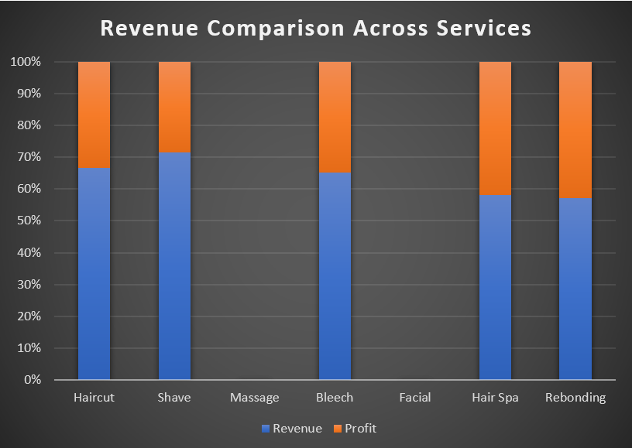
objective 3
Margin and Profit Analysis of Services
DATA ANALYSIS
Profit Discrepancy Between Services:
The 100% stacked bar chart reveals a surprising misalignment between revenue and margins in Ajju Hair Salon's services.
While Haircut and Shave lead in revenue, services like Rebonding and Hair Spa boast higher margins, indicating a strategic opportunity.
01
Strategic Implications for Revenue Optimization:
The revenue and margin disparity suggests the need for a nuanced approach to service promotion and customer engagement.
The salon can strategically promote higher-margin services alongside popular ones, diversifying revenue streams and enhancing overall profitability.
02
Aligning Customer Preferences for Optimal Performance:
Leveraging the popularity of Haircut and Shave, the salon can introduce incentives or marketing campaigns to encourage patrons to explore higher-margin services.
Cross-promotion or bundling of services can strike a balance, optimizing financial performance and creating a more resilient business model.
03
07

Slide 8
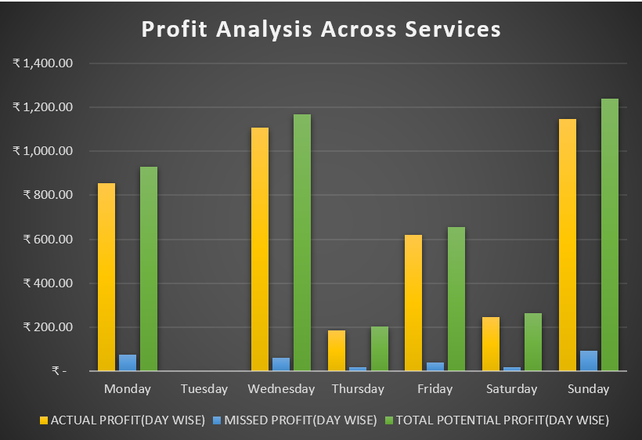
objective 4
Missed Customers and Impact on Revenue
DATA ANALYSIS
Impact of Missed Customers on Revenue:
Analysis reveals that Sundays and Wednesdays consistently have the highest number of missed customers, influencing revenue loss.
A grouped bar chart visually demonstrates this trend, emphasizing the need to address factors contributing to missed appointments on specific days.
01
Hypothetical Profit Analysis with Addressed Missed Appointments:
A grouped bar chart projects a significant increase in profit when missed appointments are considered as part of the service model.
This hypothetical scenario, though not implemented yet, showcases untapped potential within the existing customer base.
02
Strategic Consideration of Missed Appointments:
The analysis suggests that incorporating missed appointments strategically into the service framework can convert potential lost revenue into actual profit.
This forward-looking perspective highlights the importance of exploring innovative strategies to address missed appointments, underlining the potential positive impact on the salon's financial performance.
03
08

Slide 9
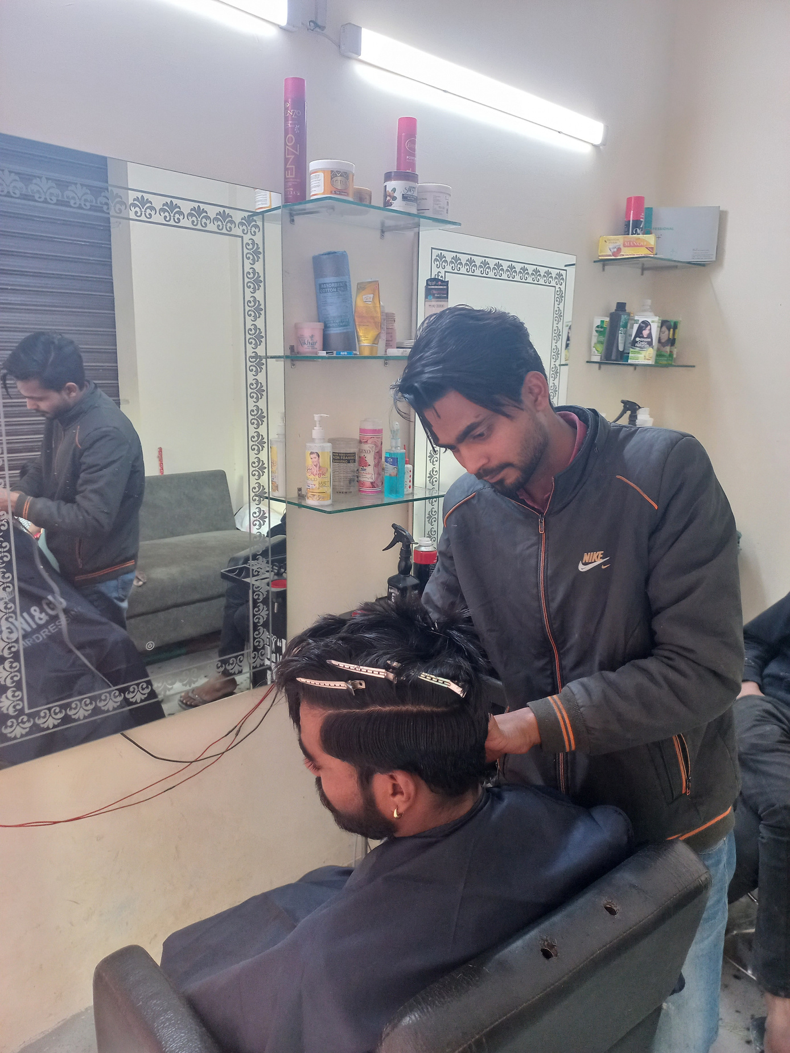
Interpretation of Results and Recommendation
Growing Customer Base: A Visual Journey Witnessing a robust ascent, Ajju Hair Salon's daily customers surged from 8 (2022) to 14 (2023) and an impressive 23 (2024). The trend line on the bar chart attests to this growth, showcasing the salon's escalating popularity.
Recommendation: To capitalize on this momentum, Ajju Hair Salon should enhance marketing with strategies like loyalty programs and targeted promotions for customer retention and acquisition.
01
Day Perception and Service Optimization
The analysis of customer perceptions reveals distinct preferences for certain days, with Mondays, Sundays, Wednesdays, and Fridays considered favorable. In contrast, Tuesdays, Saturdays, and Thursdays are viewed less positively. Understanding these perceptions unveils potential patterns in customer behavior.
Recommendation: Ajju Hair Salon can capitalize on positive day perceptions by strategically aligning promotions and events on these days. Offering exclusive discounts or unique services during perceived 'good days' can attract more customers and enhance the overall salon experience. Tailoring marketing efforts based on day perceptions can optimize footfall and customer engagement.
02
09

Slide 10
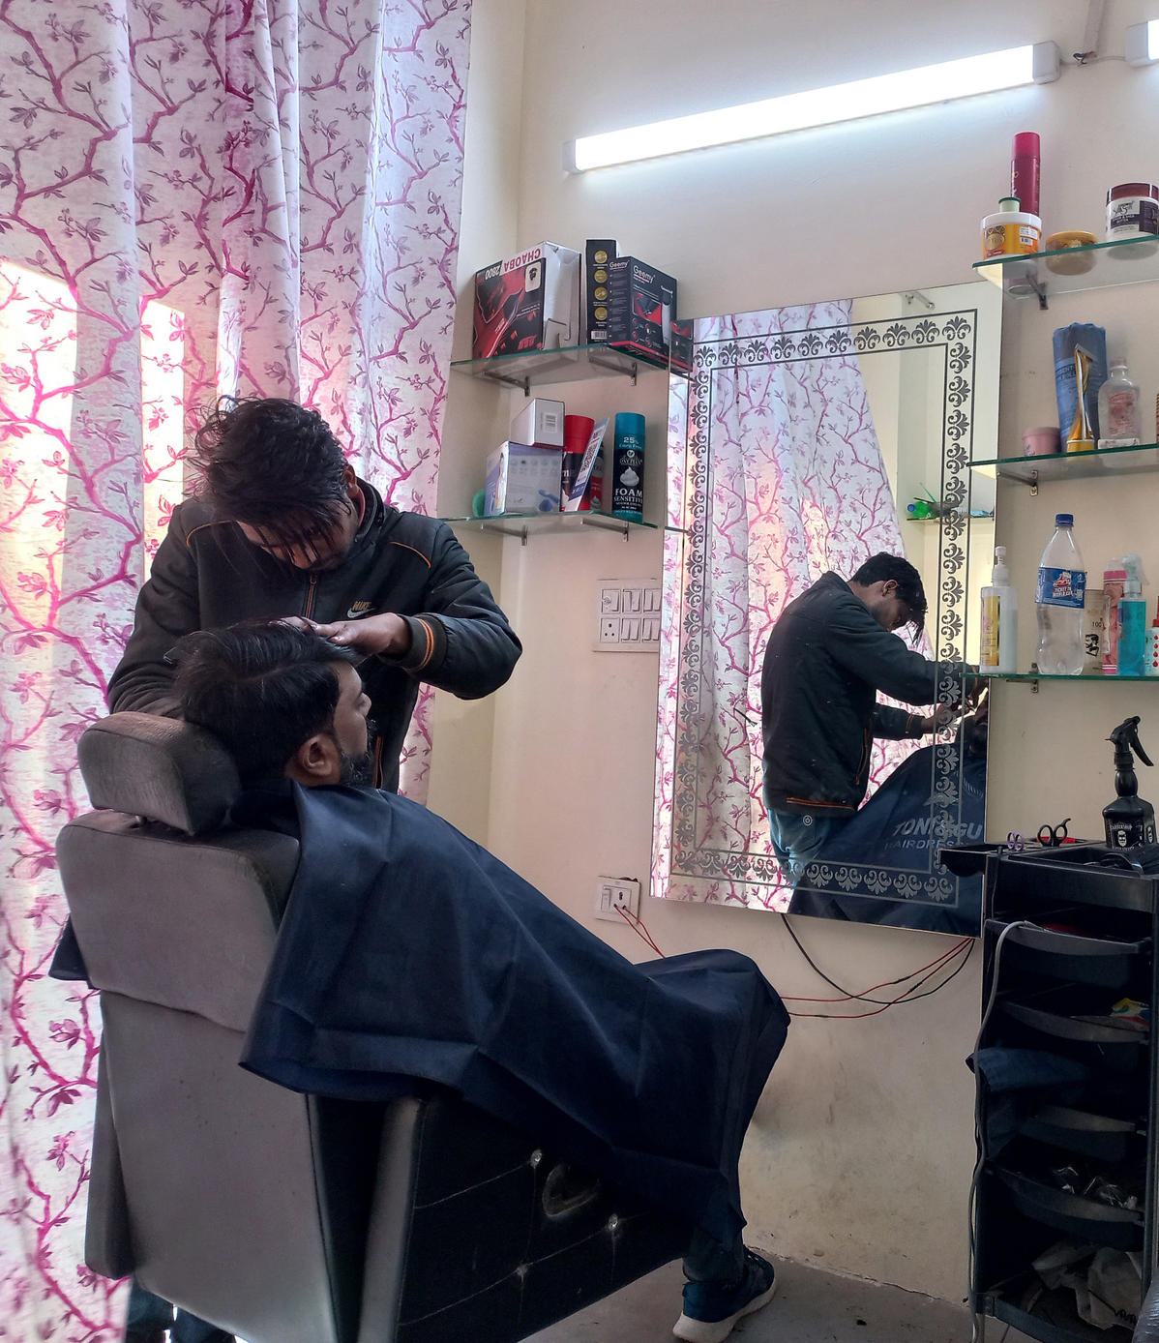
Interpretation of Results and Recommendation
Strategic Profit Optimization: The 100% stacked bar chart reveals a strategic imbalance between revenue and margins, highlighting the potential of high-margin services like Rebonding and Hair Spa.
Recommendation: Ajju Hair Salon should introduce promotions to encourage exploration of these high-margin services, diversifying revenue. Simultaneously, reshaping the premium perception of services like Rebonding and Hair Spa through targeted strategies can enhance overall profitability.
03
Unlocking Revenue Opportunities
Examination of missed appointments unveils a significant impact on revenue, notably on Sundays and Wednesdays.
Recommendation: Ajju Hair Salon should proactively address missed appointments through strategies like online booking systems and reminders, ensuring revenue stability and heightened customer satisfaction.
04
10

